Slide 1



Consumer Vs Tech Stocks Which is the better long-term buy?
Kaushik Basavaraju Monica Estrada Christian Hernandez

Slide 2
Agenda
Portfolio Analyzer
Data Collection
Executive Summary
Summary
Primary goals

Slide 3

Portfolio Analyzer
Evaluating which industry between consumer stocks and tech stocks would be a better long-term investment through projecting returns over a 10-year period.
Comparing the performance of a portfolio consisting of consumer stocks and a portfolio consisting of tech stocks. To gain a better understanding of the trends for both industries we will be investigating the following stocks.
Tech
Google (GOOGL)
NVIDIA (NVDA)
Apple (AAPL)
Microsoft (MSFT)
Amazon (AMZN)
Consumer
Johnson & Johnson (JNJ)
Walmart (WMT)
Kellogg (K)
Coca-Cola (KO)
Proctor and Gamble (PG)
3

Slide 4


Primary goals
Risk
Return

Slide 5
Motivation & Summary
This project involves evaluating which industry, between consumer stocks and tech stocks, would be a better long-term investment by projecting returns over a 10-year period. The aim is to compare the performance of a portfolio consisting of consumer stocks and a portfolio consisting of tech stocks.
To accomplish this project, one needs to analyze the historical performance of both industries and predict their future growth potential. Additionally, one needs to consider macroeconomic factors such as interest rates, inflation, and overall market conditions.
We made a hypothesis based on our findings that tech stocks would outperform consumer stocks and market as a whole.
5

Slide 6
Questions & Data
What would be the best timeframe ?
How much money do we allocate?
How do we measure the performance of tech and consumer stocks to the overall market?
How much historical data would we need?
How do consumer stocks and tech stocks compare in terms of volatility and risk?
What factors should be considered when projecting returns over a 10-year period?
6

Slide 7
Data Collection
We picked yfinance (Yahoo Finance) because it is a popular python library that provides a more efficient way to download and access historical market data.
We chose this library as a data source for this project because it provides a user-friendly interface for accessing historical market data, and it allows for easy integration with other Python libraries and tools used for data analysis and visualization.
It returns data directly into Pandas data frames.

Slide 8
Data Cleaning
Data Cleaning
To collect the data, we first imported the yfinance library into our Python environment and collected historical stock prices for the five consumer stocks and the five tech stocks in our portfolios. We specified the time range for our data, which was 10 years, and set the frequency of the data to daily.
After downloading the data we segregated the data by separating tech and consumer stocks, we explored it by examining its structure, summary statistics, and visualizations to identify any issues such as missing data or outliers. We also performed data cleaning to remove any duplicates, fill in missing values, and remove any outliers that may have been caused by data errors.
After cleaning the data, we calculated various financial metrics such as daily returns, cumulative returns, volatility, and beta to analyze the performance of the portfolios over time. We also used various visualization tools to help us better understand the trends and patterns in the data.

Slide 9
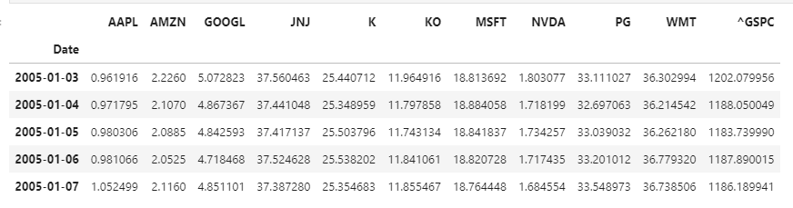
Tech and Consumer Stocks
We put together a data frame of both tech and consumer stocks as well as the S&P 500(^GSPC)
index as a benchmark used to represent the performance of the U.S Stock Market and overall U.S Economy

Slide 10
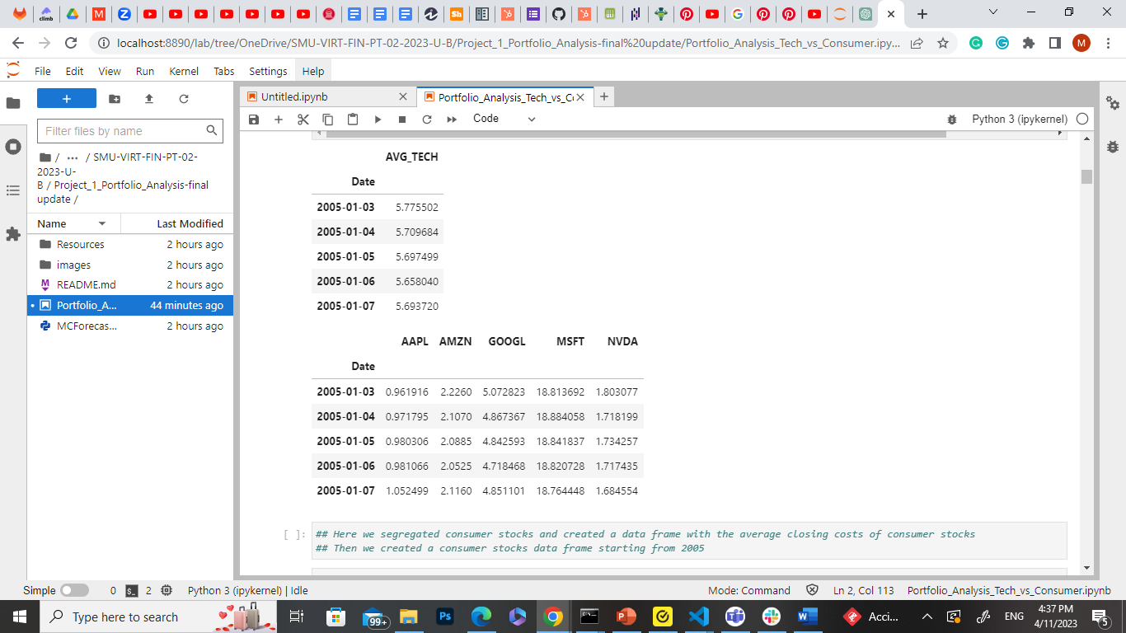
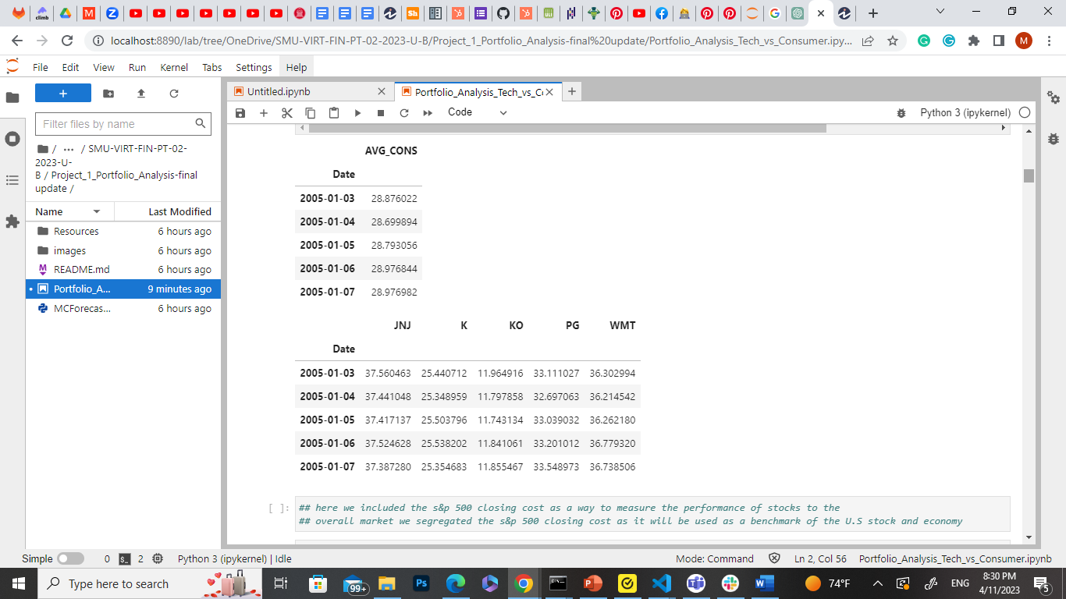
Average
We created a data frame for the average of both tech and consumer stocks for each day starting from 2005
Consumer stocks starting in 2005 is ahead in price compared to tech stocks
Average Tech Stocks
Average Consumer Stocks

Slide 11
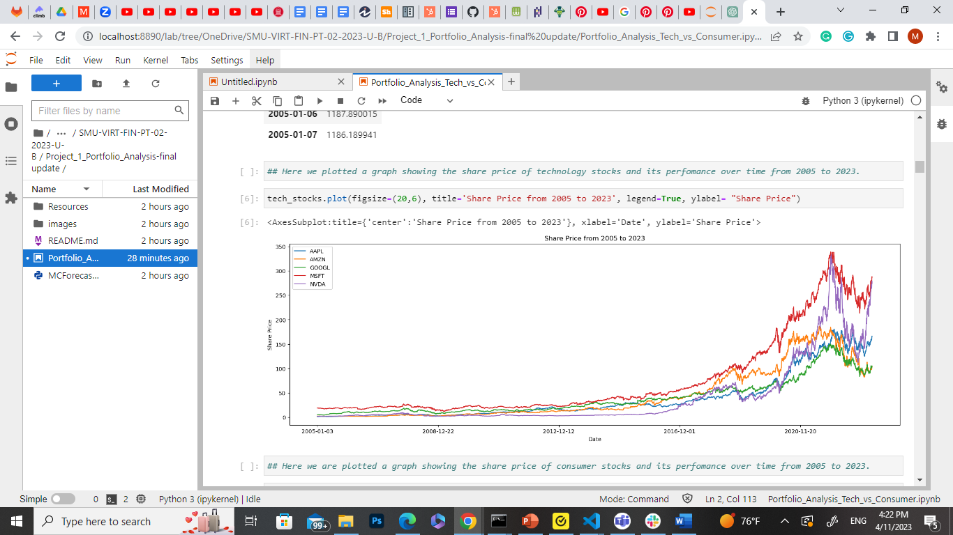
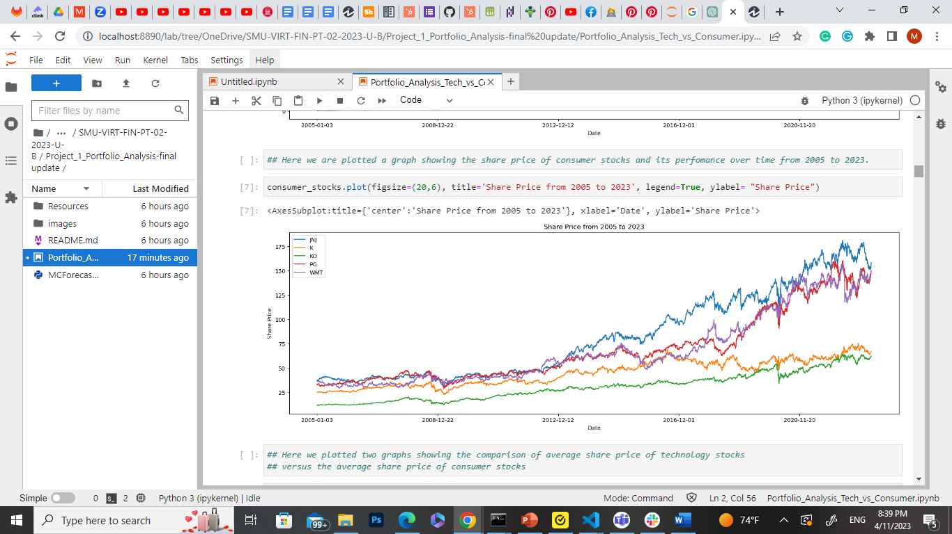
Technology vs Consumer Share Price
Tech Stocks
Share price chart of both consumer and tech stocks
Significant rise in tech stocks after 2012
Consumer stocks is steadily rising
Consumer Stocks

Slide 12
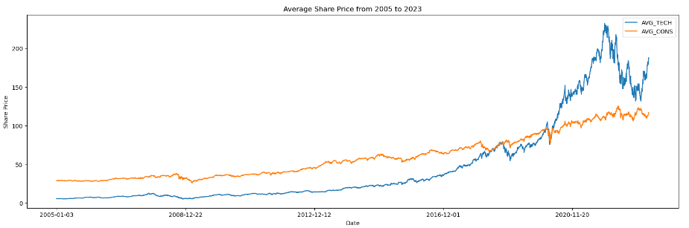
Technology Vs Consumer Average Share price
Putting it all together here is the comparison of average share price of tech and consumer stocks
Consumer stock share price is surpassed by tech stocks as it nears the 2020 year

Slide 13
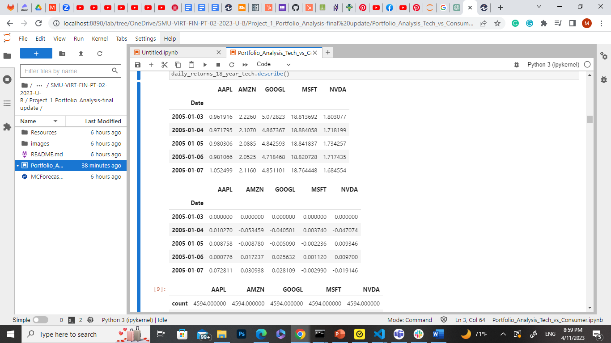
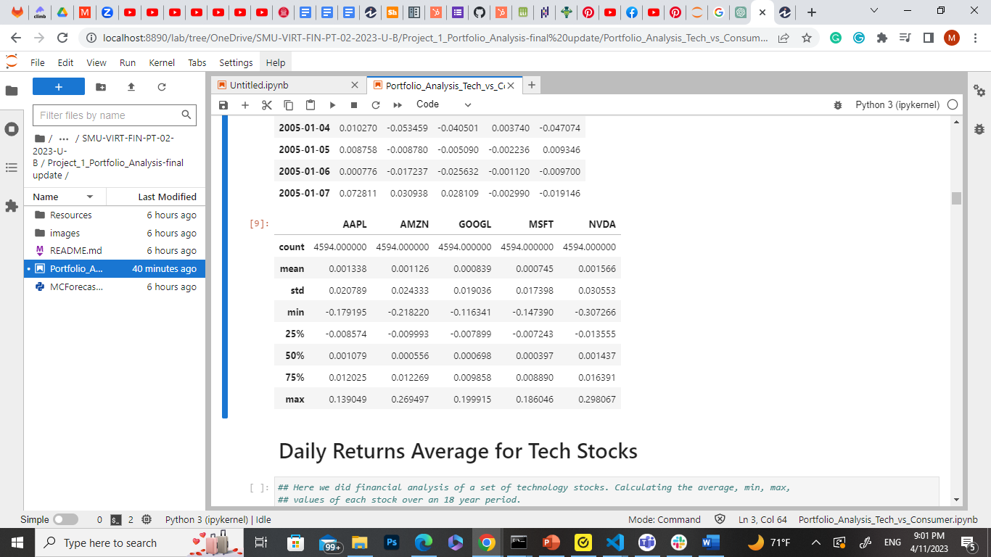
Daily Returns Tech Stocks
Daily Returns of Tech Stocks over an 18 Year period
Statistics

Slide 14
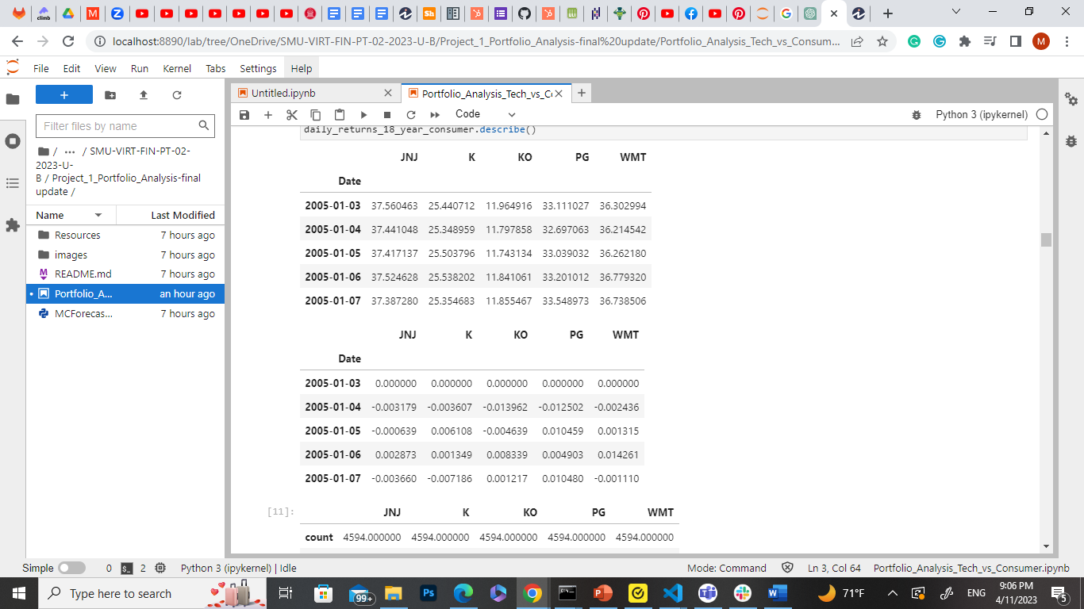
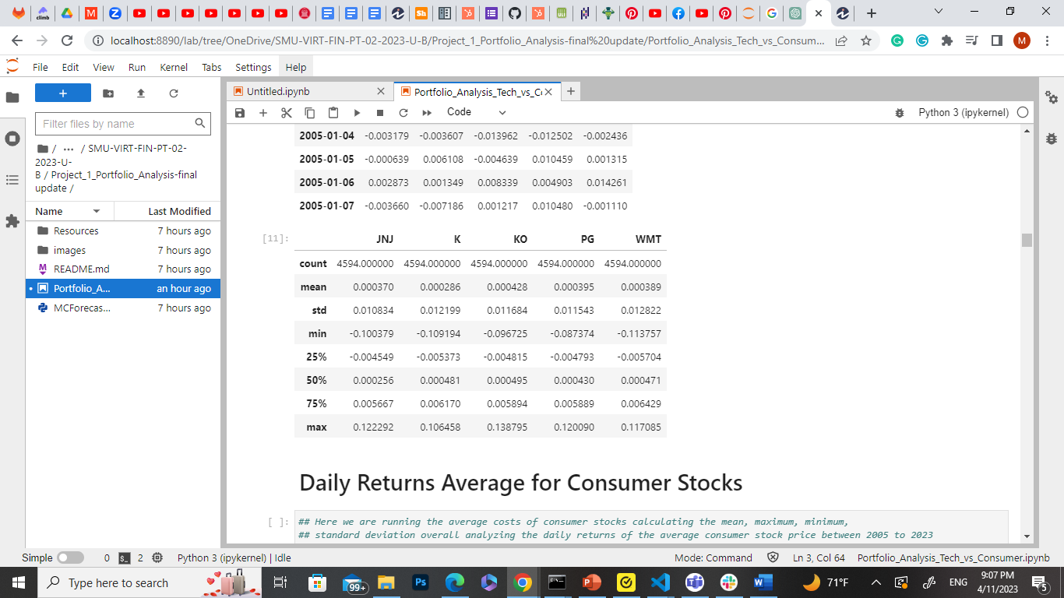
Daily Returns Consumer Stocks
Daily Returns of Tech Stocks over an 18 Year period
Statistics

Slide 15
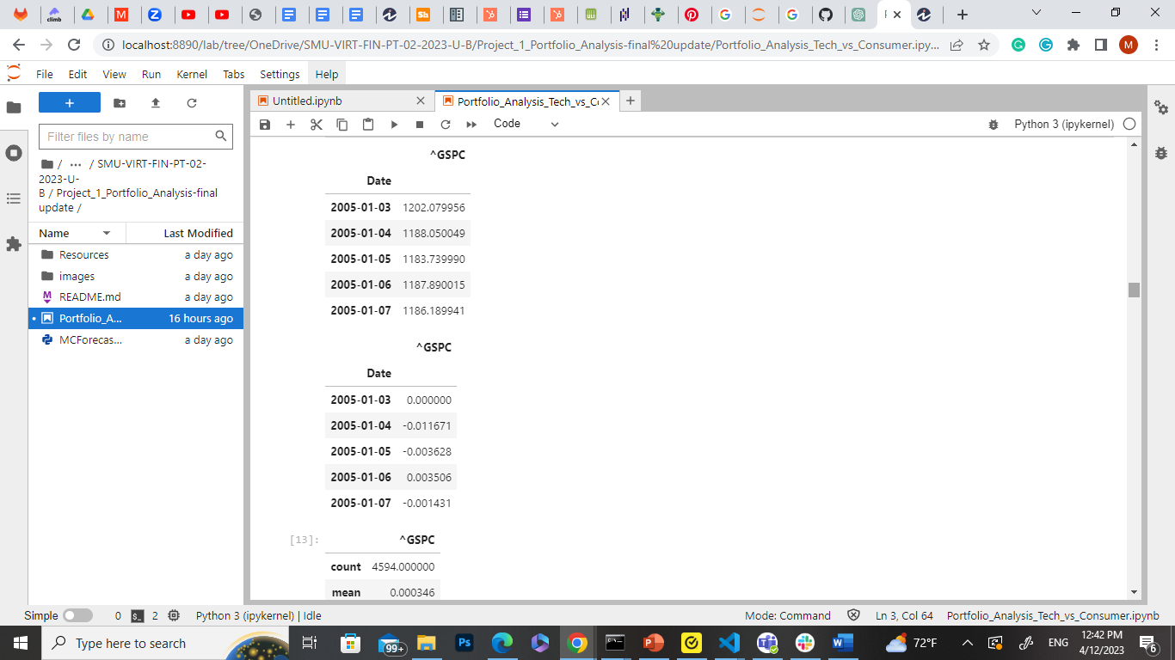
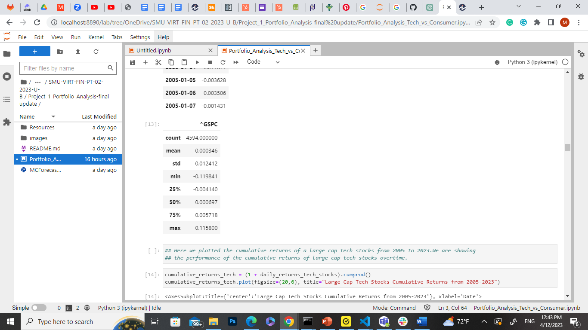
Daily Returns S&P 500
Why S&P 500?
Statistics
S&P 500 is included as an index
Acts as a benchmark to U.S Stock and Economy
Is used to compare performance of each portfolio

Slide 16
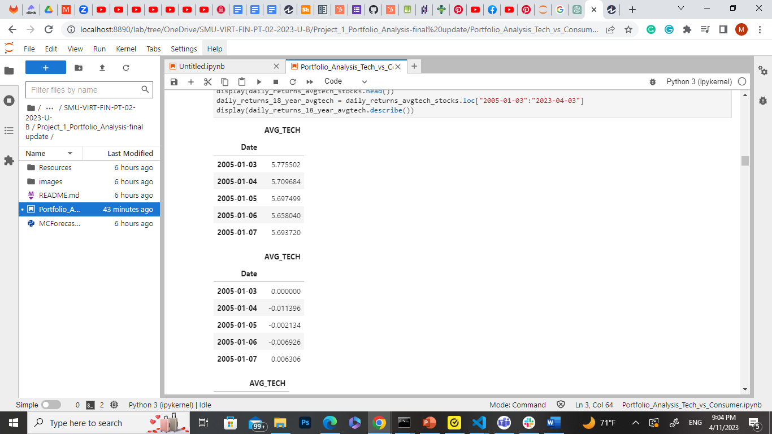
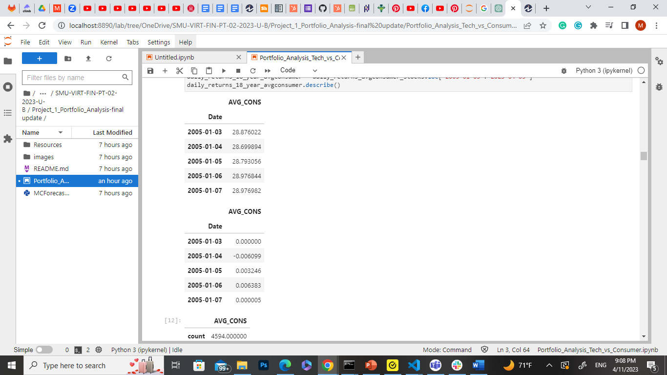
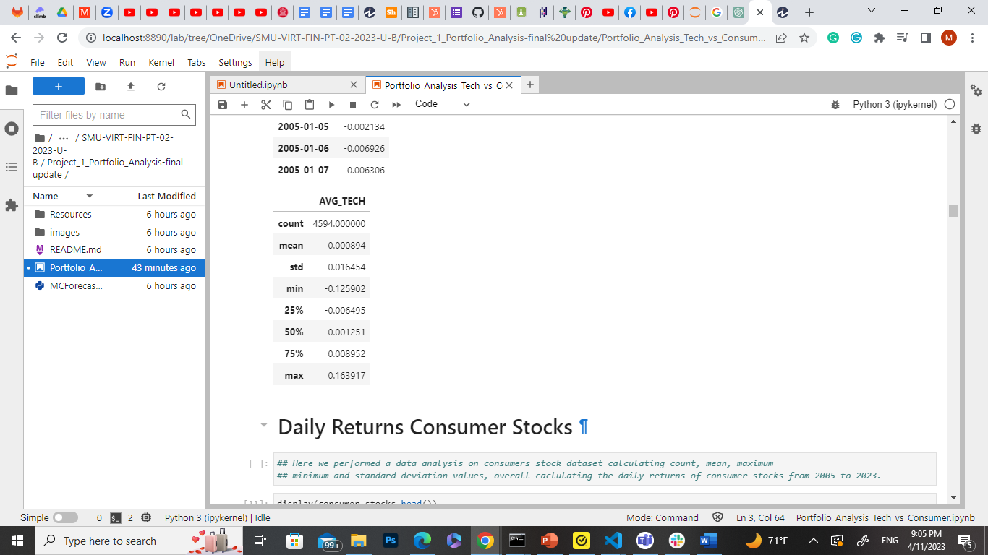
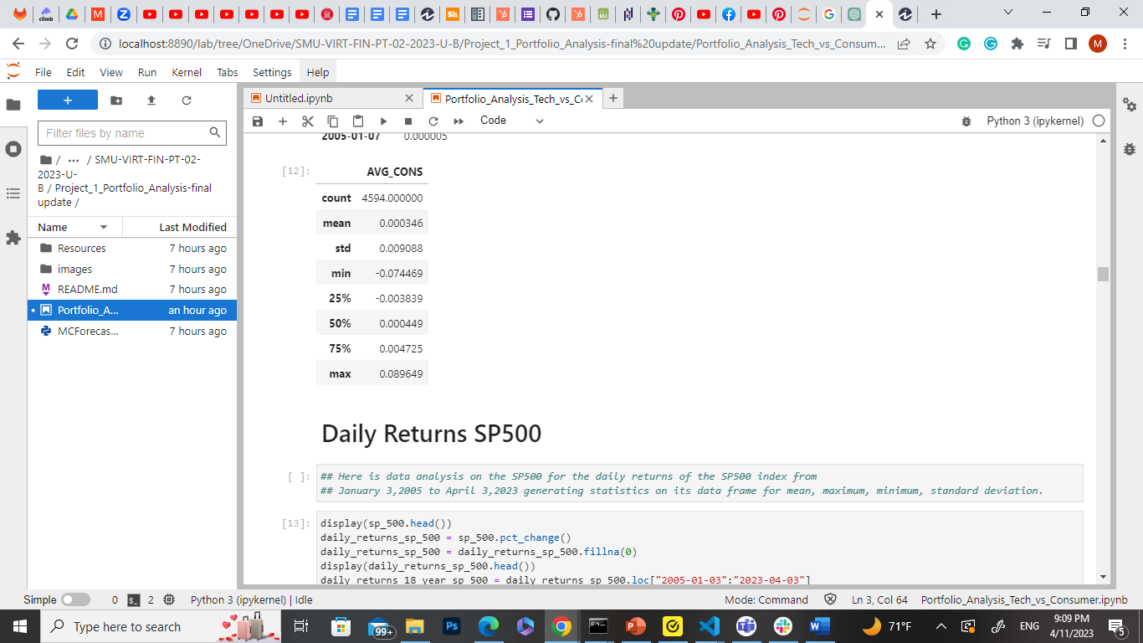
Daily Returns Average Tech and Consumer Stocks
Tech Stocks
Consumer Stocks
Statistics
Statistics

Slide 17
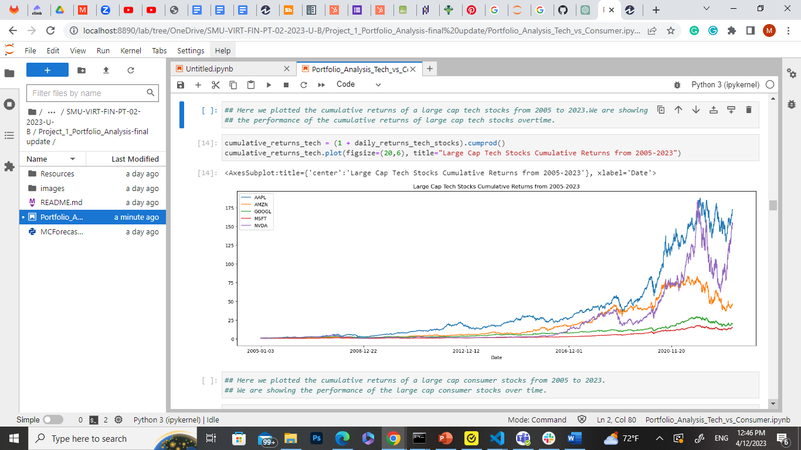
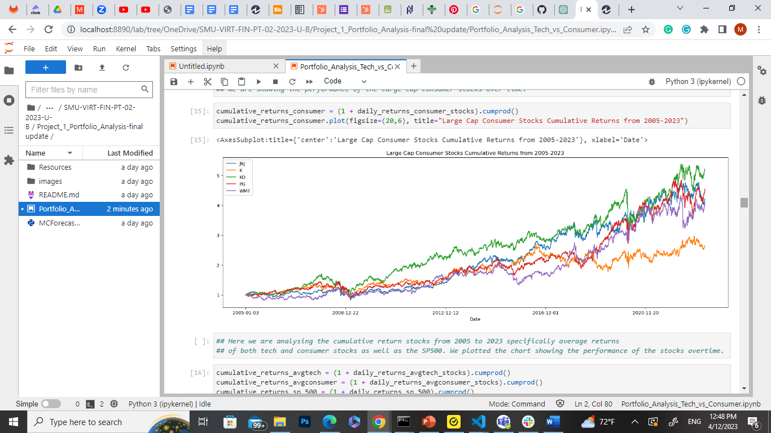
Cumulative Returns Tech and Consumer Stocks
Cumulative returns of tech and consumer stocks over an 18-year period
Graph shows a significant increase in returns for tech stocks before 2020

Slide 18
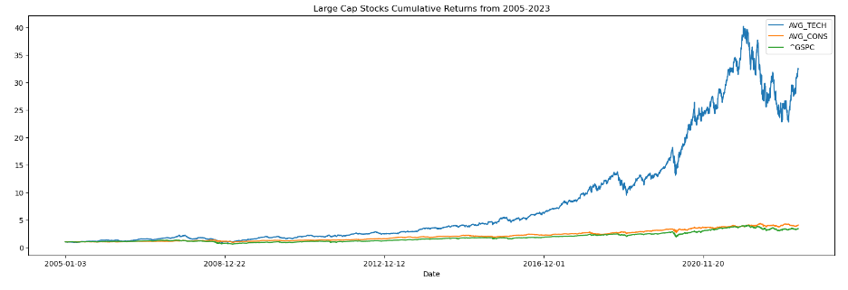
Cumulative Returns of Tech, Consumer and S&P 500
Large Cap Cumulative Returns on Average Tech and Consumer stocks as well as the S&P 500
Demonstrates a greater return in tech stocks overtime
Consumer and SP500 remain constant

Slide 19
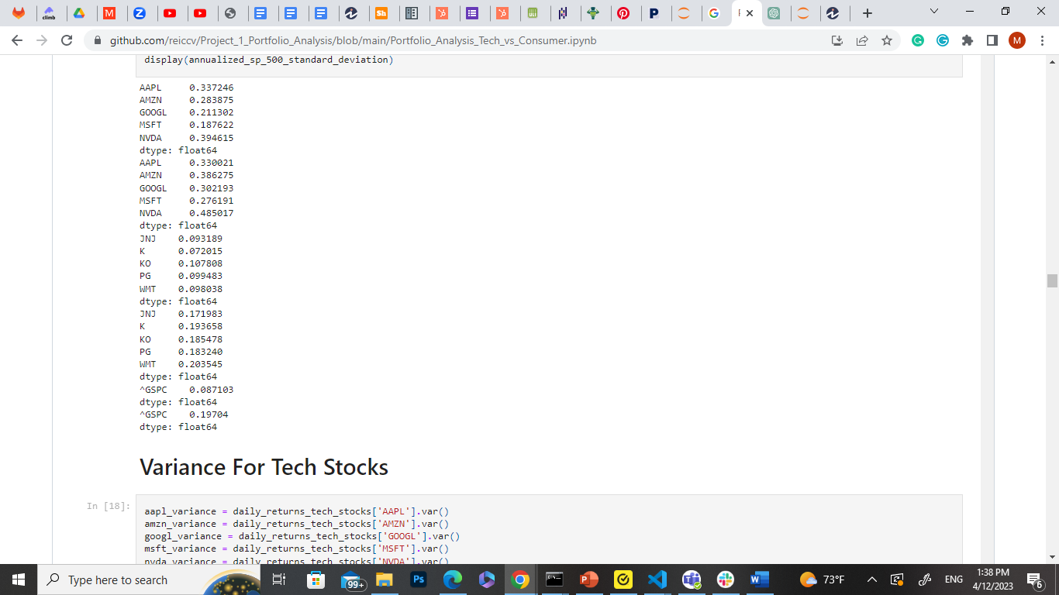
Annualized Returns/Annualized Standard Deviation
Time Frame: 2005 -2023
Tech Stocks
Consumer Stocks
S&P 500

Slide 20
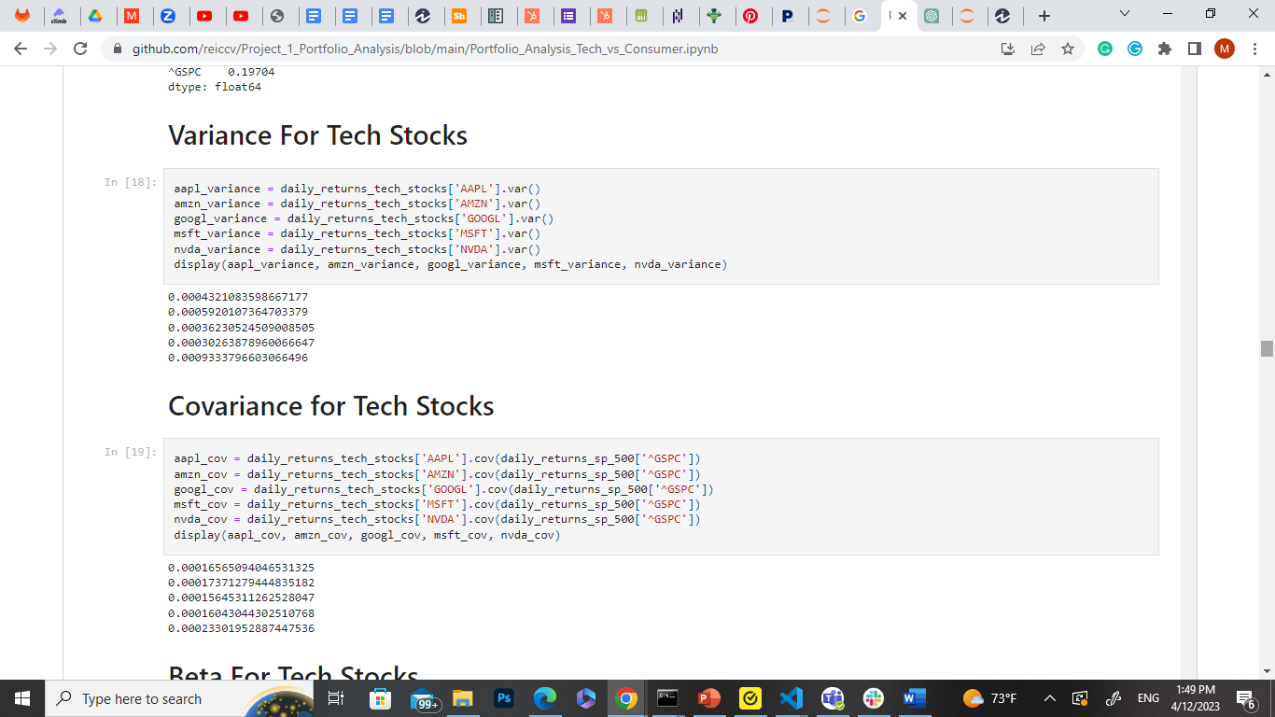
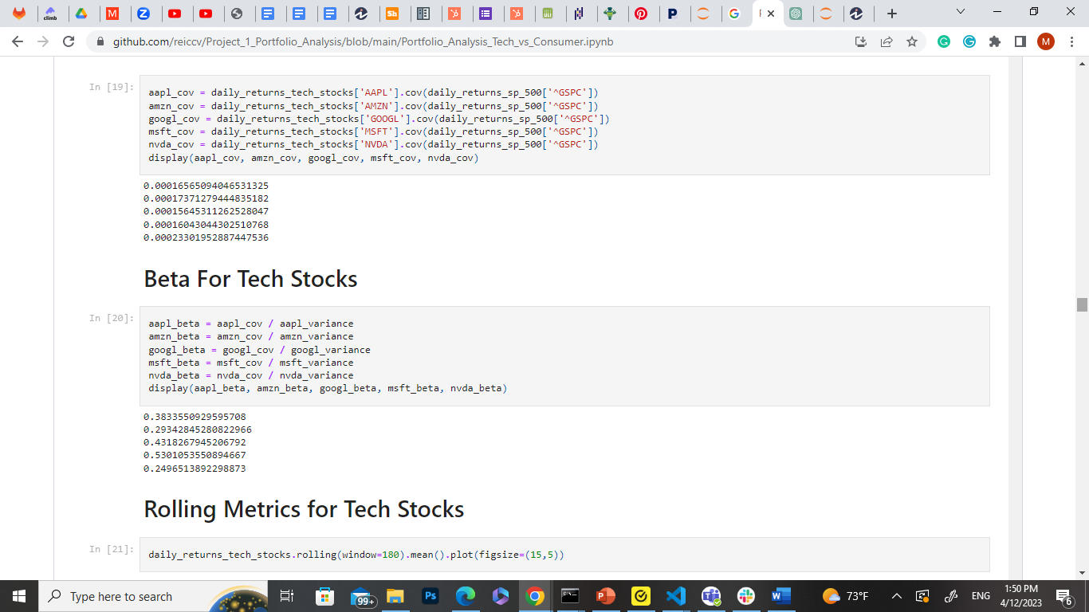
Variance/Covariance/Beta Tech Stocks
Variance for Tech Stocks
Covariance for Tech Stocks
Beta for Tech Stocks

Slide 21
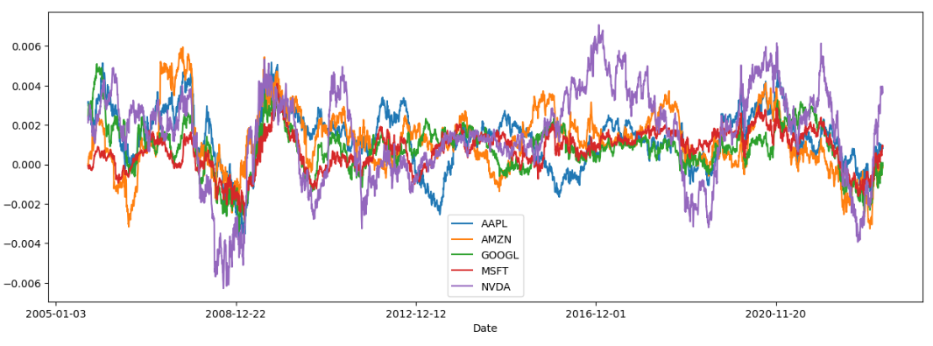
Rolling Metrics Tech Stocks
Plotline using daily returns of tech stocks overtime through the Rolling method with a window of 180 trading days

Slide 22
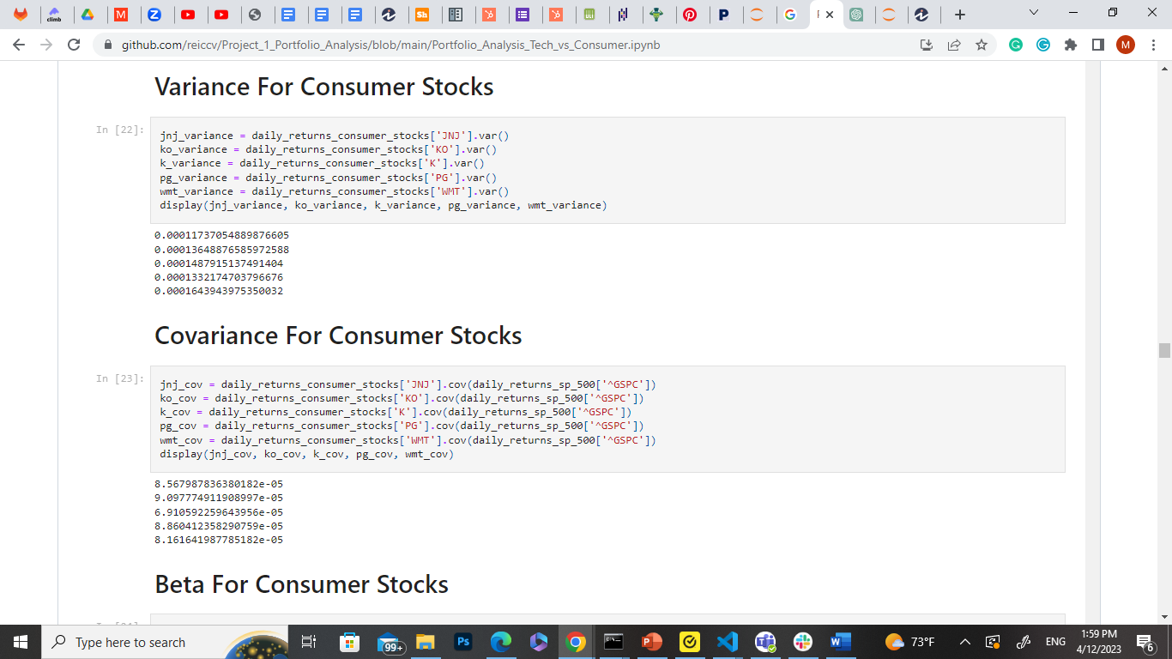
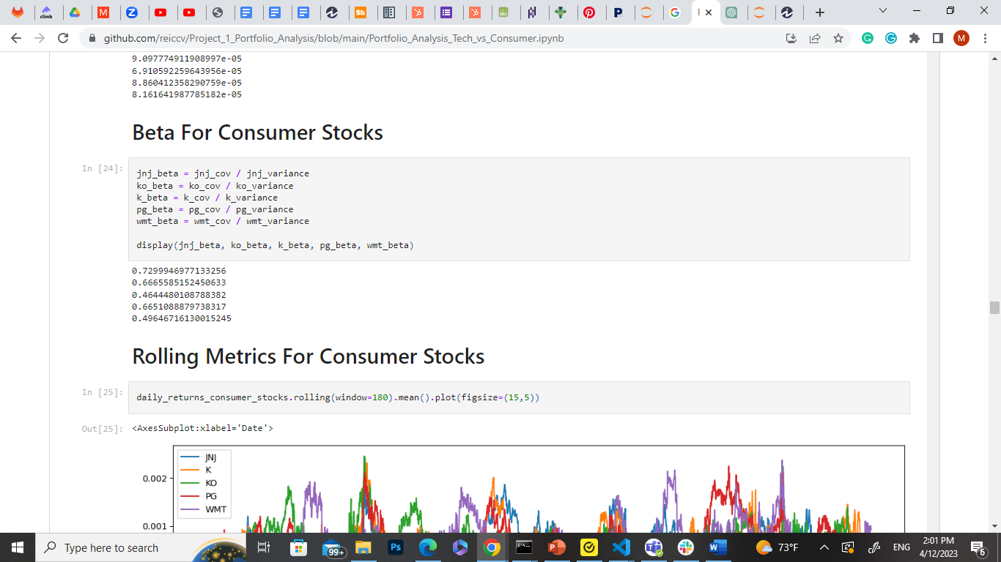
Variance/Covariance/Beta Consumer Stocks
Variance for Consumer Stocks
Covariance for Consumer Stocks
Beta for Consumer Stocks

Slide 23
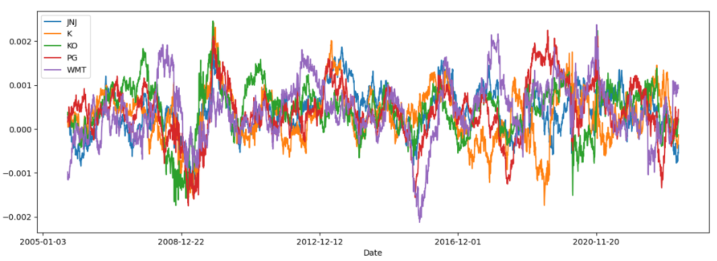
Rolling Metrics Consumer Stocks
Plotline using daily returns of consumer stocks overtime through the Rolling method with a window of 180 trading days

Slide 24
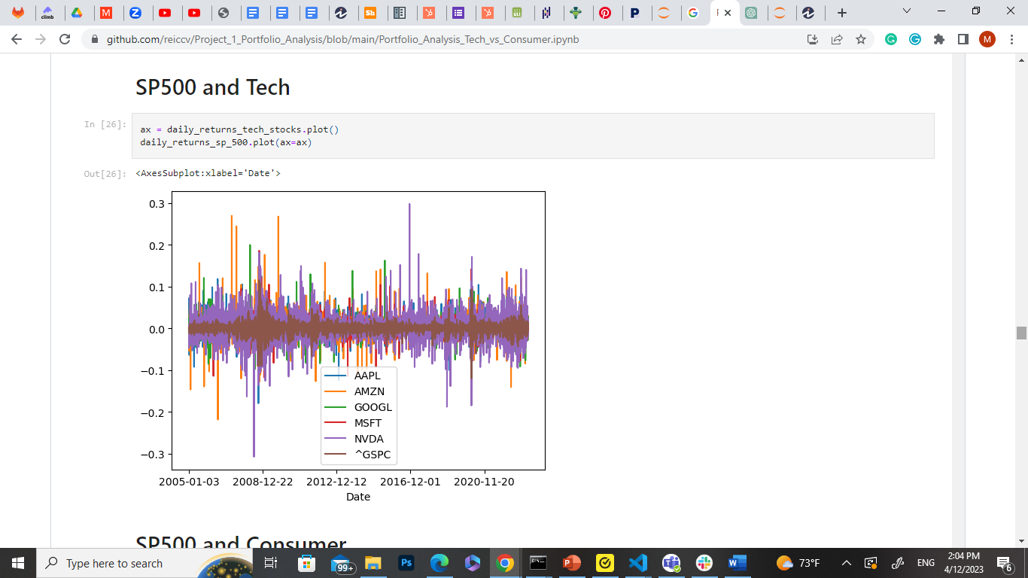
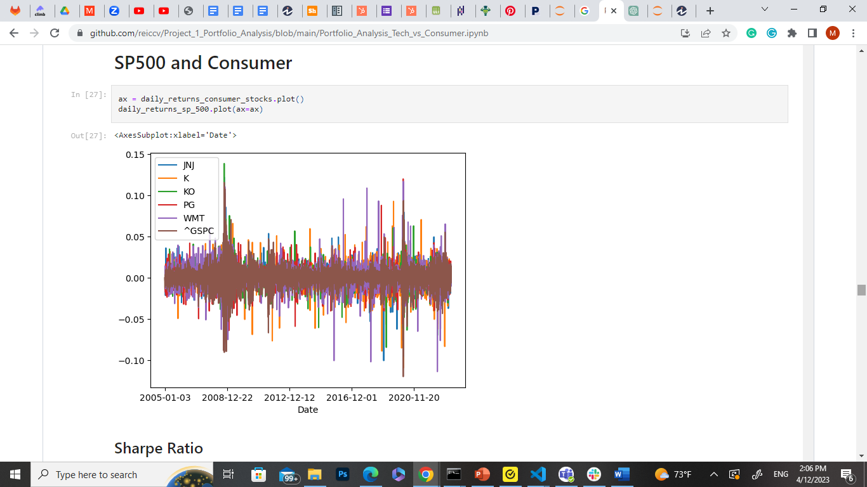
S&P 500 /Tech and Consumer Stocks
S&P 500 and Tech
S&P 500 and Consumer
Comparison of tech and consumer stocks to the S&P 500

Slide 25
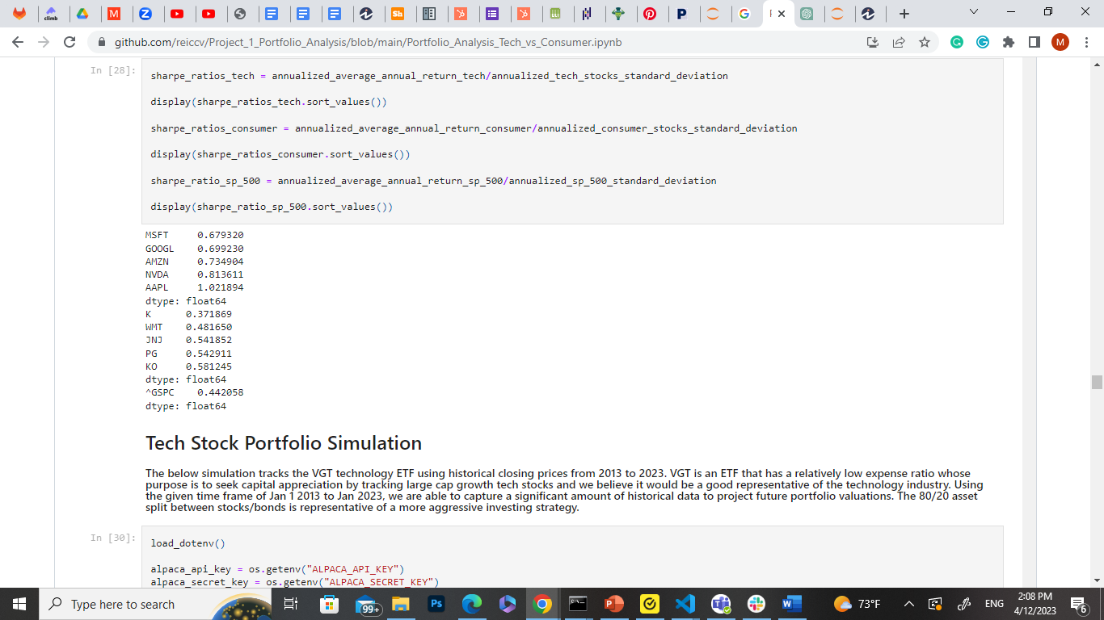
Sharpe Ratio
Tech Stocks
Here we measured the return of investment along with risk Apple Stock returned a Sharpe Ratio of over 1 defining a good return
Here it shows tech stocks overall performing better
Both tech and consumer portfolios perform better than the S&P 500 Sharpe Ratio values
Consumer Stocks
S&P 500

Slide 26
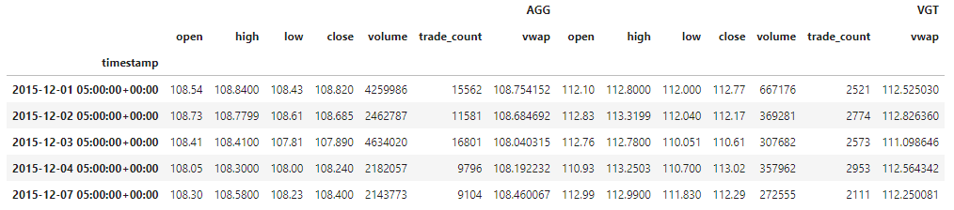
Tech Stock Portfolio Simulation
Below simulation tracks VGT Technology ETF using historical closing prices from 2013 to 2023.

Slide 27
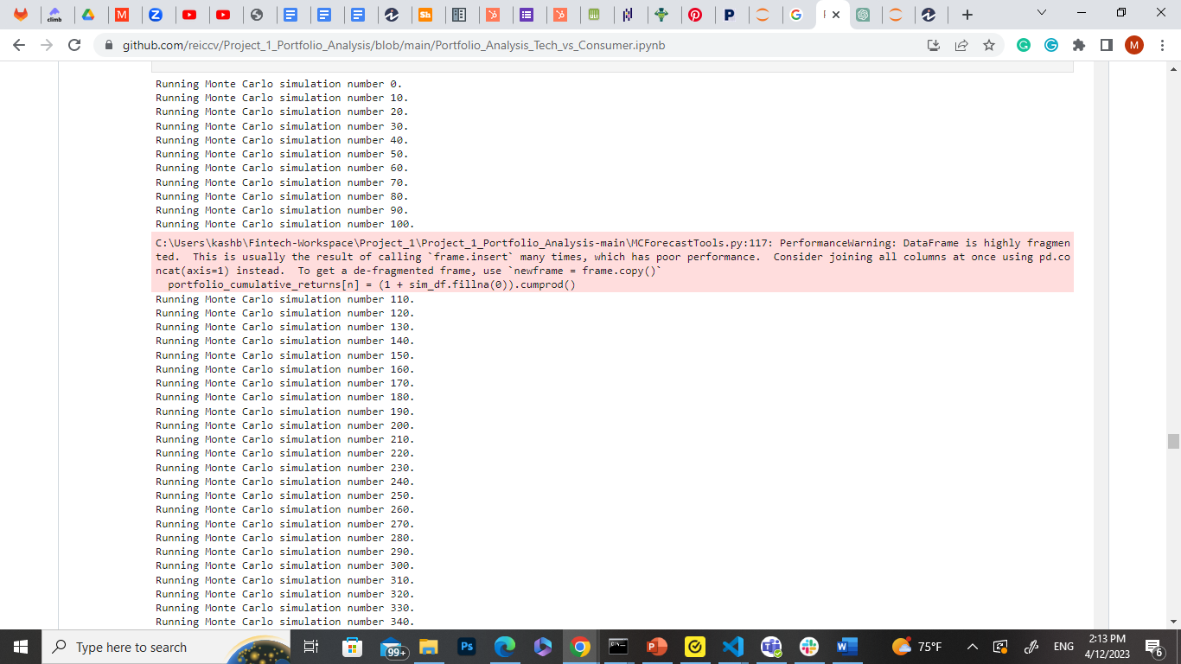
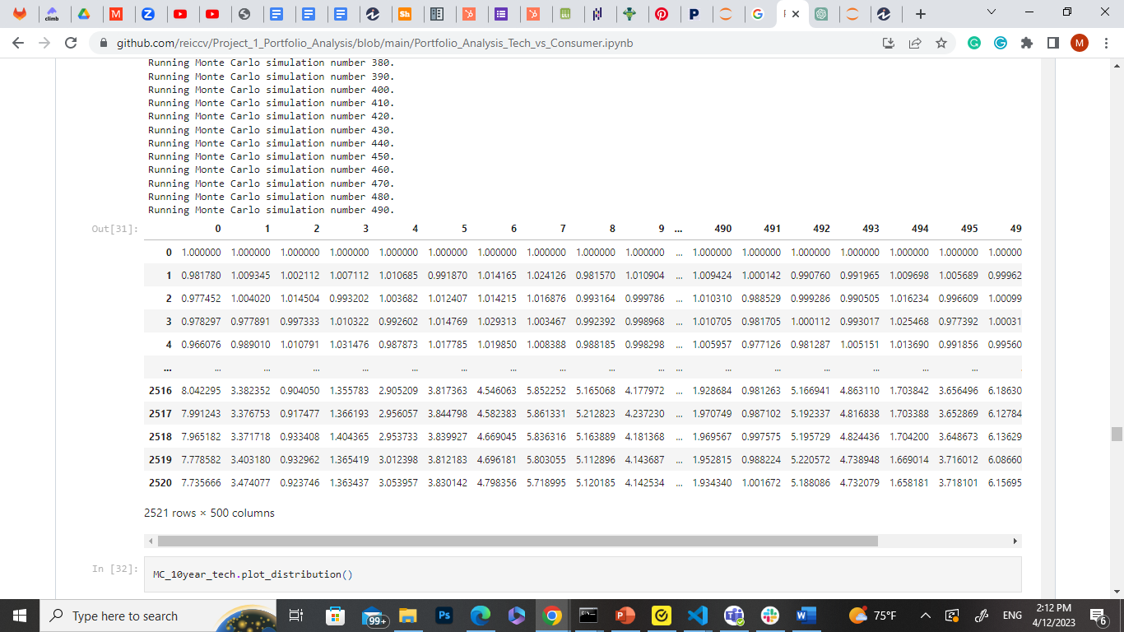
Monte Carlo Simulation /Tech
We performed a Monte Carlo Simulation on six tech stocks running 500 simulations for a 10-year investment in the technology portfolio

Slide 28
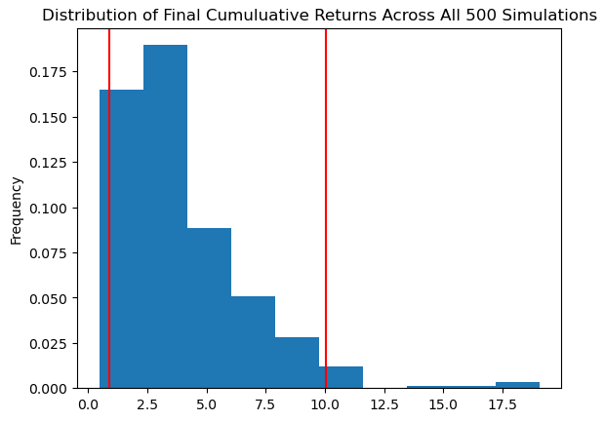
Distribution of Cumulative Returns
Probability Distribution Plot of the Cumulated returns calculated in the Monte Carlo Simulation previously
Used to visualize the range of potential outcomes for the portfolio across a 10-year investment and level of return

Slide 29
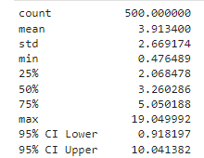
Monte Carlo Simulation/ Tech/Summary Statistics
After one simulation these are the sampled summary statistics
There is a 95% chance that an initial investment of $50,000 in the portfolio over the next 10 years will end within the range of $45,909.85 to $50,2069.10
The average valuation of this simulation over 10 years is $195,669.98

Slide 30
Consumer Stocks

Slide 31
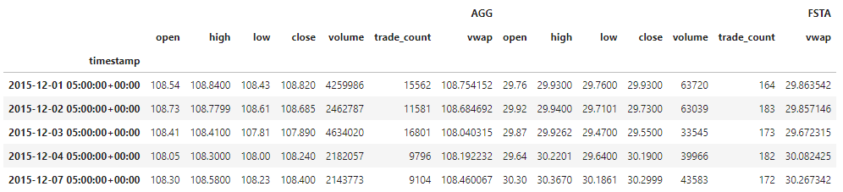
Consumer Stocks Portfolio Simulation
This simulation tracks the FSTA ETF using historical prices from 2013 to 2023. FSTA is an ETF and its purpose is to track large cap consumer industry stocks as an overall index for the consumer industry.

Slide 32
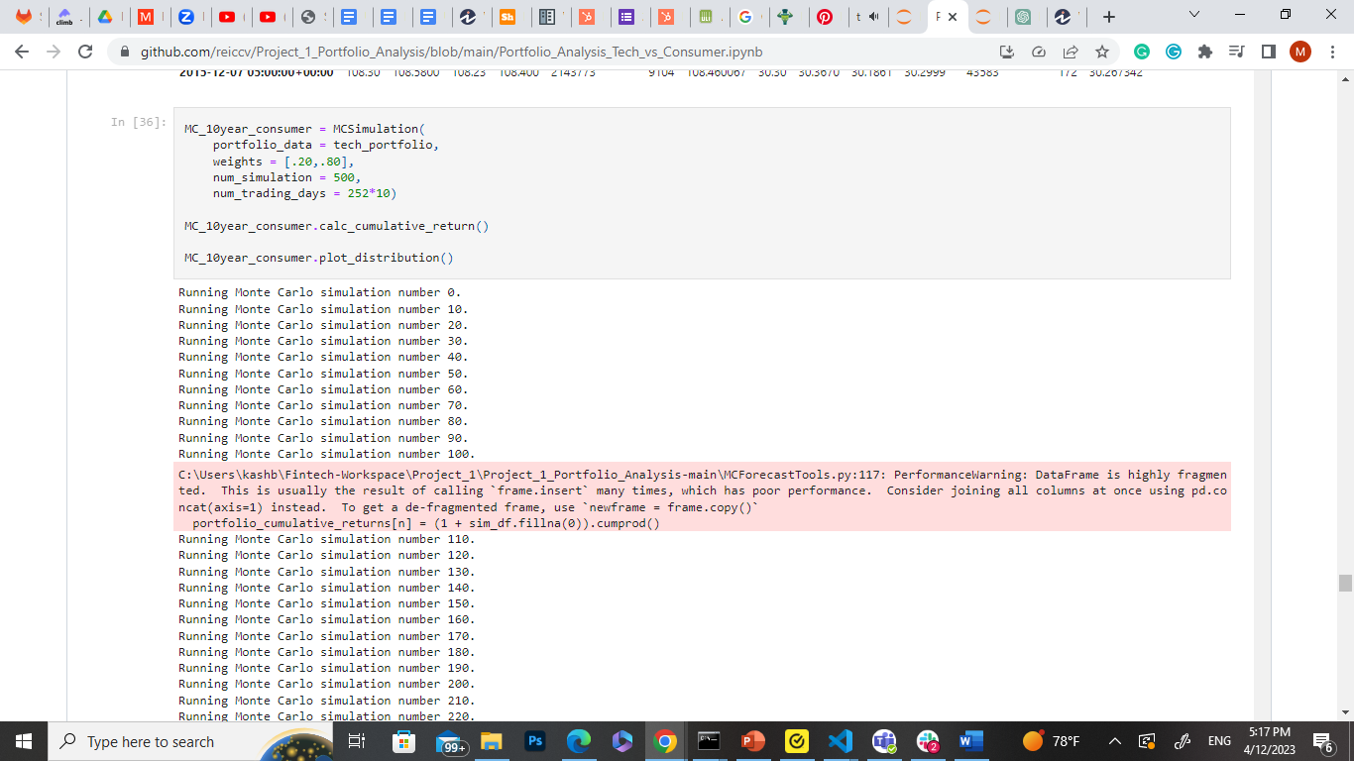
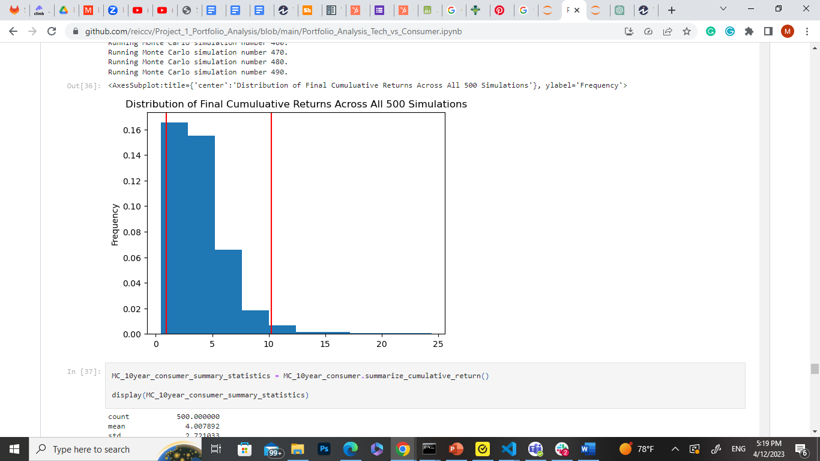
Monte Carlo Simulation/ Consumer Stocks
We performed a Monte Carlo Simulation on six tech stocks running 500 simulations for a 10-year investment in the technology portfolio
Probability Distribution Plot of the Cumulated returns calculated in the Monte Carlo Simulation previously
Used to visualize the range of potential outcomes for the portfolio across a 10-year investment and level of return

Slide 33
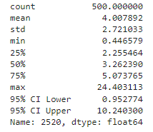
Monte Carlo Simulation/ Consumer Stocks/ Summary Statistics
After one simulation these are the sampled summary statistics.
There is a 95% chance that an initial investment of $50,000 in the portfolio over the next 10 years will end within the range of $47,638.70 to $512,014.98
The average valuation of this simulation over 10 years is $200,394.58

Slide 34
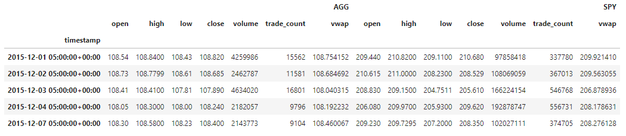
Benchmark Portfolio Simulation

Slide 35
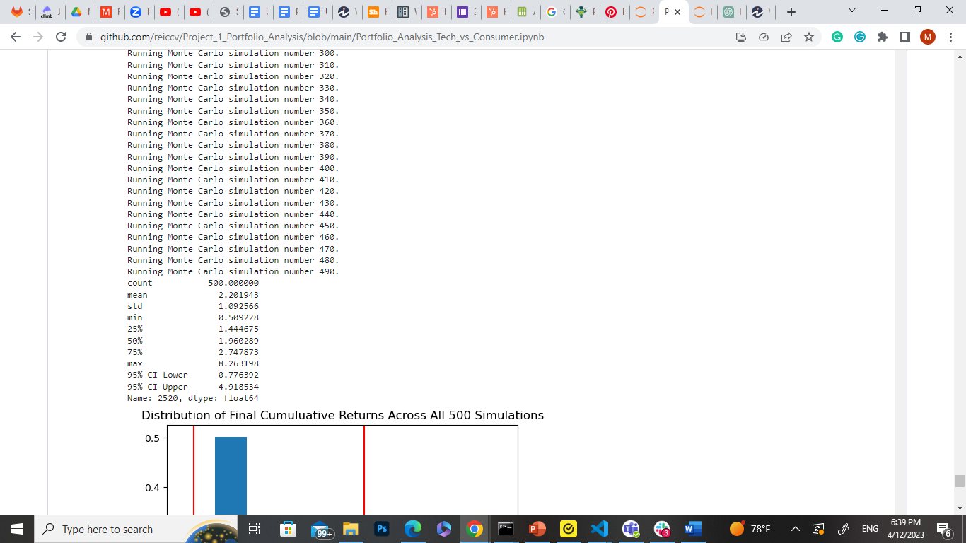
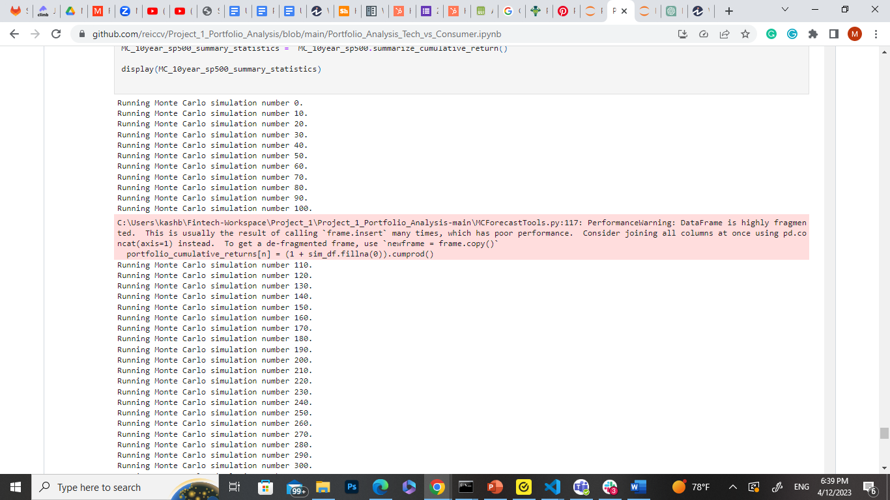
Benchmark Portfolio Simulation
There is a 95% chance that an initial investment of $50,000 in the portfolio over the next 10 years will end within the range of $47,638.70 to $512,014.98

Slide 36
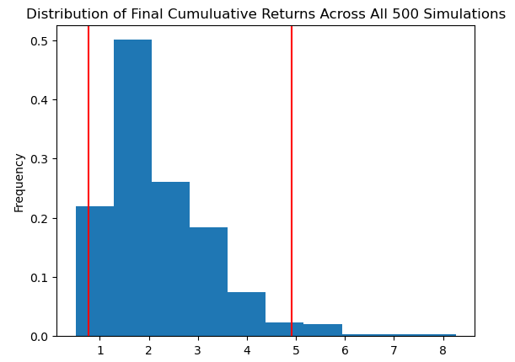
Benchmark Portfolio Simulation
There is a 95% chance that an initial investment of $50,000 in the portfolio over the next 10 years will end within the range of $38,819.59 to $512,014.98

Slide 37
Findings
Initial hypothesis it is that tech stocks would outperform consumer stocks and S&P500 but was disproven
Both portfolios outperformed S&P500 Index but did not differ from each other in any statistically significant way
Variables: timeframe, use of different index funds and asset allocations within the simulation
Takeaways:
- Significance of using ETF/ Index Funds over allocating cost basis to any individual stocks
Recommendation : Seek ETFS with lower expenses ratios, whose purpose is to seek capital appreciation, with high percent allocations in tech/consumer stocks with large market capitalizations

Slide 38
Difficulties
Choosing the appropriate timeframe proved to be difficult as it resulted in numbers that were difficult to clarify and defend. We ended up changing it many times.
Afterthought
Suppose we had chosen different stocks to analyze instead of relying on high-performing stocks that are well-known and established as successful.
If we had diversified the portfolio by including crypto or real estate, what could have been the potential outcome?

Slide 39



Thank you
Kaushik Basavaraju
Christian Hernandez
Monica Estrada

Slide 40
Q&A
Richard Branson
40

